Slide 1
Servo Conveyor line track
SDC setup guideSetup guide

Slide 2
Start up
Power on robot
Take AOA and Image Backup
If additional software is needed, load it then get new backups
Before configuring any encoder or indexer settings, you need to re designate the group 2 axis 1 servo by deleting the configuration and re-add it.

Slide 3
Servo maintenance setup
Get to maintenance setup through controlled start
Once in controlled start, menu^maintenance^group 2 independent axes^manual
Option 3 will delete the current axis
Option 2 will enter the setup guide for adding new axis

Slide 4
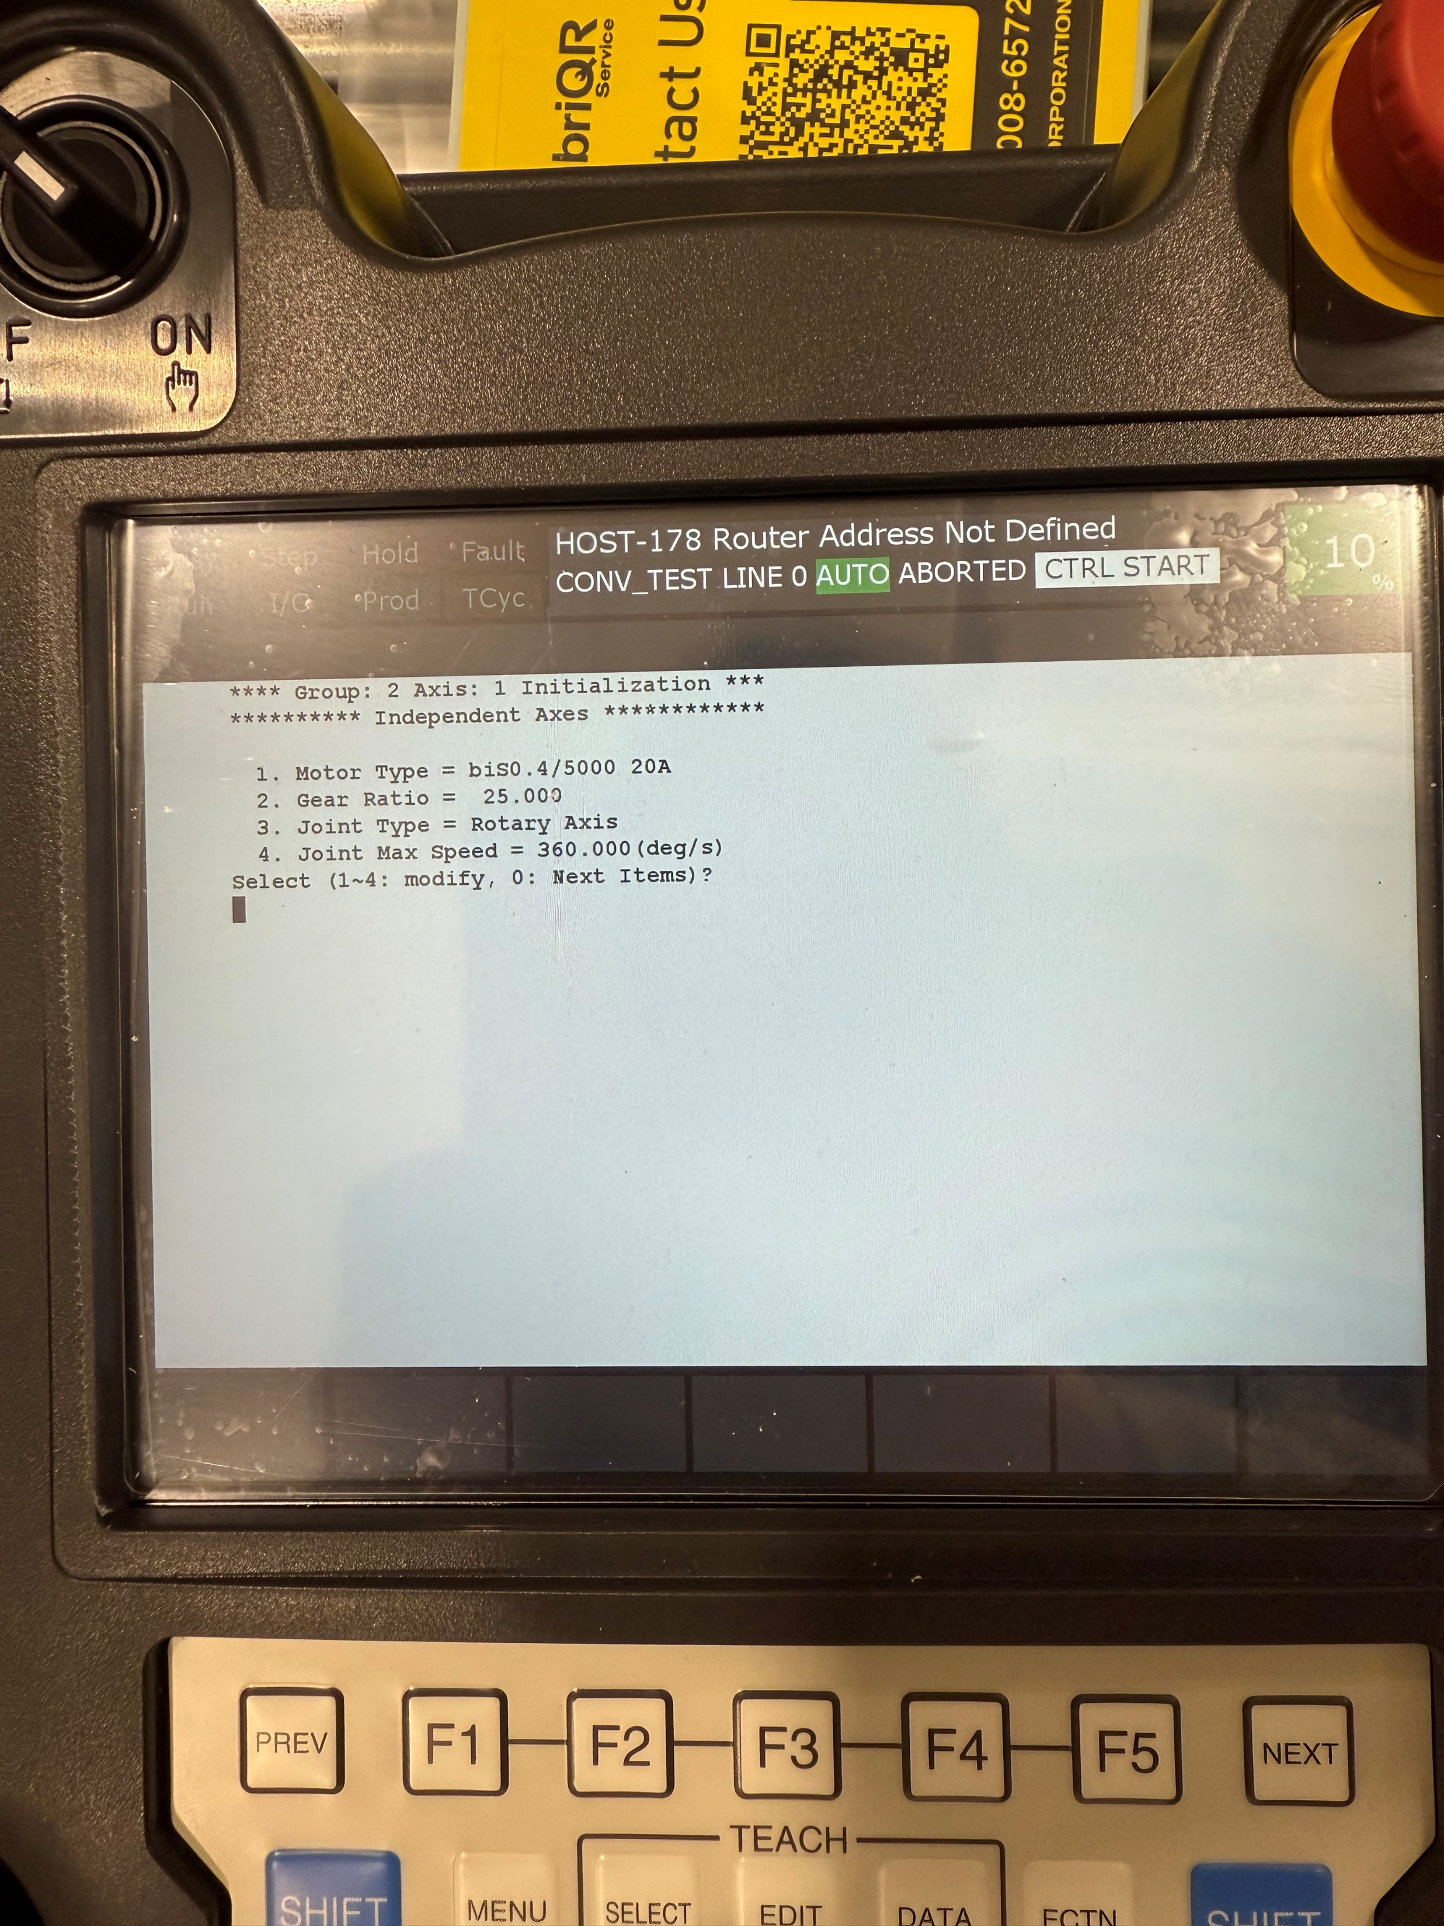
Servo setup
Select the motor size you have for the conveyor
Molex was 82. biS0.4/5000 20A
Select gear ratio. This should be the gear ratio on the gear box
Molex was a 25:1 enter 25.000
Select rotary axis
Use suggested max speed

Slide 5
Servo setup
Motion sign sets direction of rotation. False= CCW, true=CW
The rest of setting should be default
Upper limit =180deg
Lower limit =-180deg
Master position = 0
Accel time1=384
Accel time2=192
Minimum Accel Time= 384

Slide 6
Servo setup
Load ratio set to 3.00
Amplifier number = 2
Amplifier type = 2
Brake number = 1
Servo off enable =enable
Servo off time = 20.000
End setup, Function^cold start

Slide 7
Cold start setup
Servo will have a pulse mismatch, go to setup^system^variables^$DMR_GRP^GRP2^ set mastering done to true
Type^master/cal^MAKE SURE YOU ARE IN GROUP 2 on teach pendant!!!
Press calibrate for group 2
Jog the conveyor make sure that it is moving in the right direct +x should move conveyor towards the robot. It should also rotate 180degrees and reset to -180degrees. And should be a constant rate.

Slide 8
Setup encoder and indexer and continuous turn
Start with the indexer setup. Menu^next^next^indexers
Set encoder to encoder 1, set to continuous, press detail on continuous
Motor gear teeth =1
Rotor input gear teeth = ratio of gear box
rotor output gear teeth = teeth of the conveyor drive
Conveyor teeth= 1
Conveyor tooth distance= distance for belt tooth to tooth
Press exec when done and cycle power

Slide 9
Cold start setup
After exec this will configure the encoder, continuous turn and indexer settings
This will alter the maintenance gear ratios and speed limits for the servo
Servo should be setup and ready for line track setup

